Slide 1

BGEC 103: BUSINESS COMMUNICATION WEEK 3 ORGANISATIONAL COMMUNICATION

Slide 2

OUTLINE
The nature of organisational communication
Internal Communication (upward, horizontal, downward and diagonal)
External Communication
Functions of organisational communication
ICT and its influence on work

Slide 3
INTRODUCTION
Organisational communication is the flow of information among and between individuals in organizations.
Alvesson (2002) characterises communication as the essential element that sustains organisations, often described as the "social glue" or "life-blood" that holds them together.
Similarly, Davis (1953) conceptualises communication as the "nervous system" of an organisation, underscoring its critical role in maintaining organisational functionality.
The interconnectedness of social, cultural, and economic structures is deeply embedded within various organisational contexts, including educational institutions, religious establishments, social clubs, and workplaces. According to Pearson et al. (2017), effective and ethical communication within these organisational settings significantly influences individuals' prospects for personal, social, and economic advancement.
Given its centrality to organisational processes, the structuring of communication channels is crucial to ensuring effective information exchange and overall organisational efficiency.

Slide 4
LEARNING OUTCOMES
By the end of this lecture, the student should be able to:
define organisational communication and describe the nature of organisational communication.
explain the concept of internal and external communication in the organization.
Identify the differences between formal and informal communication in an organisation
distinguish between upward, downward, horizontal, lateral and diagonal communication.
explain the relevance of business communication to the growth of the organisation and building good corporate relationship.
Explain ICT related communication in the organizational terrain.

Slide 5
THE NATURE OF ORGANISATIONAL COMMUNICATION
Communication within the organisation comes in two forms: Internal (Formal and Informal) and External.
Internal communication is the flow of information within an organization.
This form of communication is classified into formal and informal communication.
In an organisation, information flow from management to employees (downward), employees to management (upward) and between employees (horizontal).

Slide 6
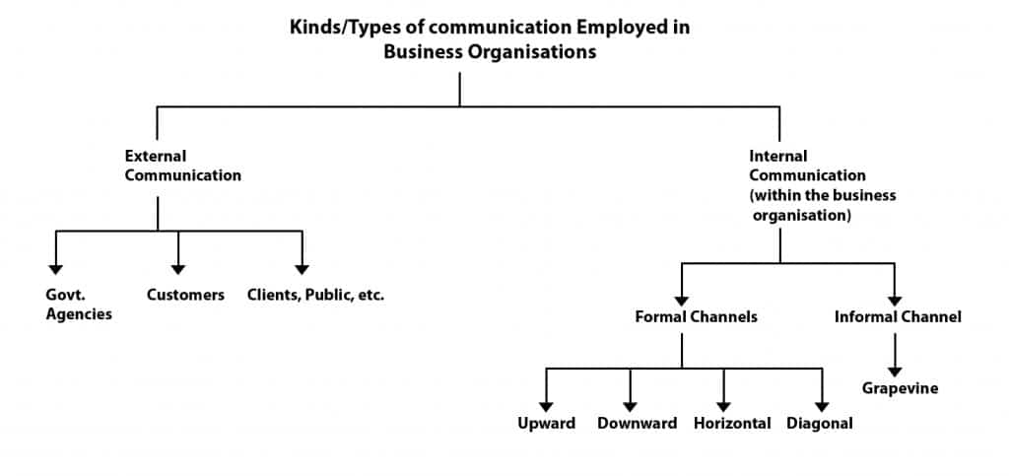

Slide 7
INTERNAL COMMUNICATION
a) FORMAL COMMUNICATION
Formal communication involves the official flow of information prescribed by the chain of command of an organisation.
Thus, formal messages flow downward or upward (vertically), horizontally, and diagonally.
Formal communication networks allow people to handle predictable and routine situations.

Slide 8
INTERNAL COMMUNICATION
b) INFORMAL COMMUNICATION I
Not all messages flow through the officially authorised channels prescribed by the organization’s chain of command.
Many messages flow along an informal network commonly called informal communication or the grapevine.
The grapevine is the major informal communication channel that transmits rumors (Davis, 1978: 112).
Informal communication exists because of limitations of formal networks.

Slide 9
INFORMAL COMMUNICATION II
Grapevine carries information about the organization, such as policy changes, impending layoffs, or workload revisions (Deetz, 1995).
For instance, information carried by the grapevine is 75 to 95% accurate (Caudron, 1998).
Grapevine messages are often more accurate than formal ones because status, power, and rank differences seem less important.
Information carried by the grapevine travels fast.

Slide 10
INFORMAL COMMUNICATION III
The use of e-mail and blogs have caused grapevine news to travel even faster.
If an organization’s managers are open with the employees and send all necessary information through formal channels, the grapevine usually carries only personal interest or gossip.
The type of information the grapevine carries indicates the health of the organization.

Slide 11
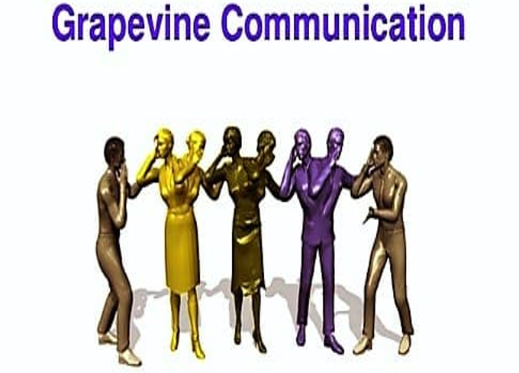

Slide 12
INTERNAL COMMUNICATION
a) DOWNWARD COMMUNICATION
It is the flow of information from top administration to lower levels or from the superiors to the subordinates.
It involves the conveying of job instructions, job policies and procedures, employee performance appraisals and motivational demands.
Downward communication can lead to information overload.

Slide 13
INTERNAL COMMUNICATION
b) UPWARD COMMUNICATION
Formal messages that flow from subordinates to supervisors/managers are known as upward communication.
Upward communication consists of the flow of performance reports, grievances, work-related challenges and other information from lower to higher levels.

Slide 14
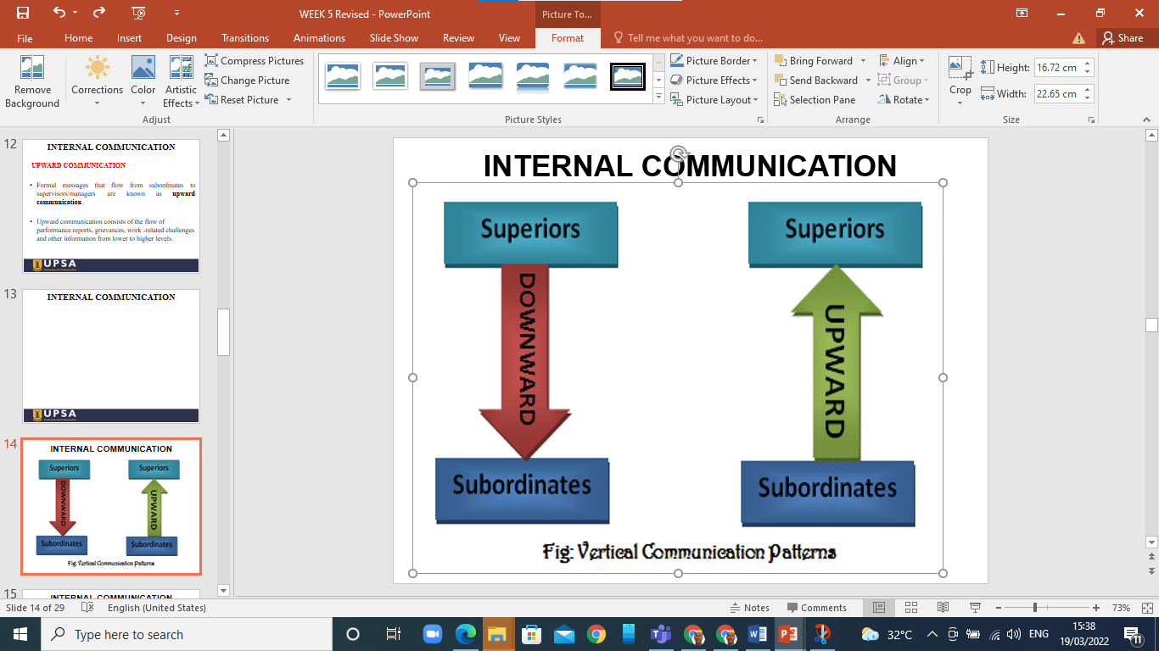
INTERNAL COMMUNICATION

Slide 15
INTERNAL COMMUNICATION
c) HORIZONTAL COMMUNICATION
It involves the flow of information laterally between people of the same rank and occurs between departments or divisions on the same level. It is important for coordinating tasks, solving problems, sharing information and resolving conflicts within employees or departments (Goldhaber, 1993). In recent times, organizations are paying much more attention to horizontal communication than they did in the past. The Internet and company intranets have made it cheaper and easier for employees to communicate horizontally.

Slide 16
INTERNAL COMMUNICATION
d)DIAGONAL COMMUNICATION
Diagonal communication is the exchange of information across different levels and departments within an organization, cutting across both hierarchical and functional lines.
It allows employees from different levels and departments to communicate directly, rather than following a strict top-down or bottom-up approach.
Examples of Diagonal Communication
A junior accountant emailing the head of marketing to discuss budget allocations for an upcoming campaign.
An IT technician discussing software needs with the operations manager instead of going through their direct supervisor.

Slide 17
FORMS OF INTERNAL COMMUNICATION
Meetings/Presentation/Team briefing
Training
Intranet
Emails
Newsletters
Phone calls
Reports
Notices
Memos
Face-to-face

Slide 18
Importance of Internal Communication
It increases engagement and free flow of information.
It increases productivity as employees understand the span of control.
It helps in the dispersing of organizational goals and objectives.
It increases trust and commitment.
It influences creativity and innovation.
It promotes better relationships at the workplace.
It makes the acceptance of change easier.
It decreases turnover and absenteeism.
It prevents industrial strikes and riots.

Slide 19
EXTERNAL COMMUNICATION
External Communication covers how organizations interact with the world outside the organisation.
For instance, organizations are required to maintain relations with other organizations, suppliers, government agencies, banks, customers, or potential customers to achieve their goals.
Diverse channels are used for external communication classified into oral, print, and/or electronic.

Slide 20
Forms of External Communication
Press release
Public speaking
Advertisement
Conference attendance and presentation
Direct mails
Letters
Websites
Brochures

Slide 21
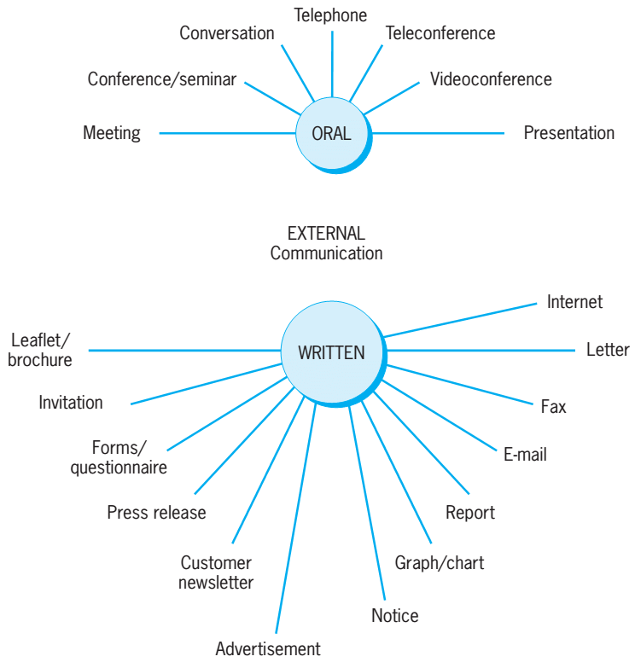
External Communication

Slide 22
Importance of External Organizational Communication
Communicating news or information: It facilitates the spreading of information and news related to organizations, to its customers, shareholders, suppliers or other people.
Image building: newsletters, press releases, media related stories are external communication channels that help build organizational image.
Potential customers: through external communication mediums like websites, social media sites like Facebook, Linkedin, inter alia, products or services are advertised.

Slide 23
Importance of External Organizational Communication
Collection of information: It helps in collecting essential information and feedback from outside the organization to develop strategies and improve customer relations.
Maintain contact with customers, suppliers and bankers: It ensure ongoing communication and positive relationships with customers, suppliers, and bankers to facilitate smooth business operations.

Slide 24
ICT related Communication in Organisations
In our current world of work, ICT has characterised communication within and outside organisations
Integral components of ICT communication
Internet
Web
Intranets (networks which use the software associated with the Web, but are internal to the organisation and usually protected from outside visitors)
Extranets (using similar technology to link business with their suppliers, and customers)

Slide 25
ICT related Communication in Organisations II
ICT communication within an organisation is through the following:
Messaging software
Document sharing software
Video conferencing software
Information Management Systems
The above ICT tools influence efficiency and effectiveness in an organisation
They help in the prompt response to customers’ needs

Slide 26
RELEVANCE OF ORGANISATIONAL COMMUNICATION
Communication promotes motivation since employees are well informed and clarified about the task to be done, how the task should be performed and how to advance their performance if it is not well done.
Information from both internal and external communication helps in effective decision making by identifying and considering different initiatives.
Organizational communication serves as a tool for socialization, orientation and controlling.

Slide 27
RELEVANCE OF ORGANISATIONAL COMMUNICATION II
It is a medium for building organizational image and serving the public relations role.
It facilitates coordination and cooperation.
It creates a conducive environment for productivity and innovation.

Slide 28
Personal qualities/skills sought by employers
Communication skills (verbal and written)
Strong work ethic
Teamwork skills (interpersonal communication)
Initiative (work with less supervision, fast learner)
Analytical skills

Slide 29
SUMMARY
1. The nature of organisational communication
2. Internal Communication (upward, horizontal, downward and diagonal)
3. External Communication
4. Functions of organisational communication
5. ICT and its influence on work

Slide 30
ACTIVITY
1. Discuss the differences between formal and informal communication.
2. Outline the importance of messages that flow upward, downward and horizontally.
3. Discuss why communication is the soul of every organisation.
4. Deliberate on the role and relevance of ICT in the world of work.

Slide 31


Slide 32
REFERENCES
Alvesson, M. (2002). Understanding organizational culture. Sage.
Caudron, S. (1998). On the contrary-They hear it through the grapevine. Workforce, 77(11), 25-27.
Davis, K. (1953). Management Communication and the Grapevine. Graduate school of Business, Administration, Harvard University.
Deetz, S. (1995). Transforming communication, transforming business: Stimulating value negotiation for more responsive and responsible workplaces. International Journal of Value- Based Management, 8(3), 255-278

Slide 33
REFERENCES II
Goldhaber, G. (1993). Organizational Communication (6th edition). Brown and Benchmark.
Hamilton, C. (2013). Communicating for results: A guide for business and the professions, pp. 28-60. Cengage Learning.
Hartley, P. & Bruckmann, C. (2007). Business Communication, pp. 67-209. Routledge, Taylor and Francis
Overton, R. (2002). Business Communication, pp. 26-28. Martin Management Services
Pearson, J.C., Nelson, P.E., Titsworth, S., & Hosek, A.M. (2017). Human Communication, pp. 192-219. McGraw Hill

Slide 34
Q & A

